Slide 1
Respiratory Disease Prediction
Presented by
Miss. Ankita Krushna Anpat

Slide 2
To develop a machine learning model that can accurately predict the nature of disease for a patients.
In a respiratory disease prediction scenario , the target column is nature involves binary classification i.e. the nature of disease is high or medium.
Problem statement

Slide 3
Data Collection
Visualization
Data Preprocessing & dtype conversion
Dataframe2
Dataframe1
Feature Selection
Class Imbalance Treatment
Dataframe3
Outliers & Skewness Treatment
Conclusion

Slide 4
About the Dataset:
Datashape: Rows = 25247
Columns = 6
Categorical Columns: Symptoms, Sex, Disease,
Treatment, Nature
Numerical Columns: Age
Target Column: Nature is the target column.

Slide 5
Data Preprocessing:
Missing Value Treatment
Data Type Conversion: using LabelEncoder

Slide 6
Dataframe 1 :
Conclusion: Here Random Forest is the best fitted model.
Sr.no. | Model Name | Accuracy | TPR | FPR | F1 Score
1 | Logistic regression | 70.356436 | 0.870886 | 0.576190 | 0.786173
2 | Decision Tree | 99.465347 | 0.995253 | 0.006349 | 0.995726
3 | Random Forest | 99.465347 | 0.995253 | 0.006349 | 0.995726
4 | SVM | 79.188119 | 0.987975 | 0.033862 | 0.983927
5 | KNN | 97.980198 | 0.651266 | 0.431217 | 0.682248
6 | Naive Bayes | 62.039604 | 0.920253 | 0.422751 | 0.846949
7 | Adaboost | 99.465347 | 0.995253 | 0.006349 | 0.995726
8 | xgboost | 99.465347 | 0.995253 | 0.006349 | 0.995726

Slide 7
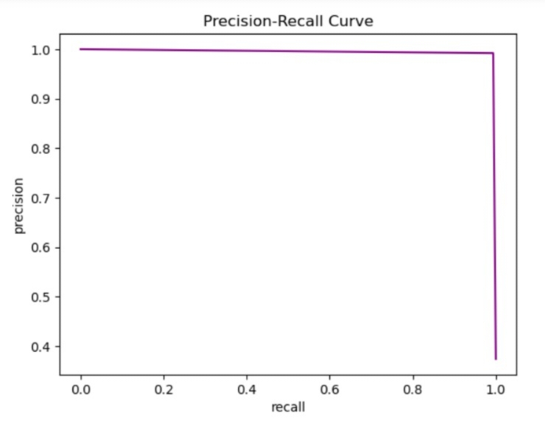
PRC Curve for Random Forest

Slide 8
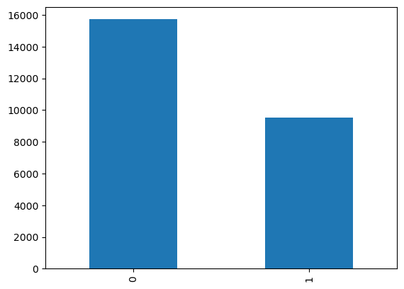
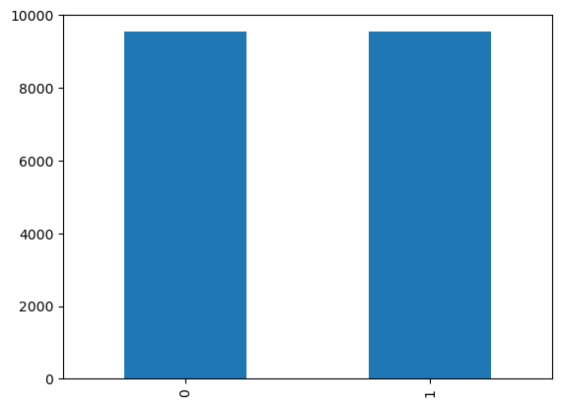
Class Imbalance: using Random undersampling method
Nature Nature
Before Class Imbalance After Class Imbalance

Slide 9
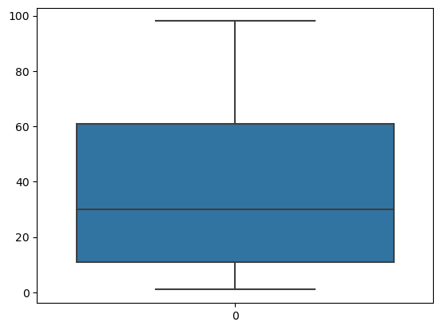
Outliers Treatment:
Age
There is no outliers for Age.
There is no skewness.

Slide 10
Dataframe 2 :
Conclusion: Here Random Forest is the best fitted model.
Sr.no. | Model Name | Accuracy | TPR | FPR | F1 Score
1 | Logistic Regression | 63.388408 | 0.573612 | 0.303243 | 0.616986
2 | Decision Tree | 99.737739 | 0.997962 | 0.001081 | 0.998471
3 | Random Forest | 99.737739 | 0.997962 | 0.001081 | 0.998471
4 | SVM | 74.114870 | 0.936831 | 0.035135 | 0.951125
5 | KNN | 95.567794 | 0.581763 | 0.396757 | 0.594947
6 | Naive Bayes | 59.113559 | 0.760061 | 0.288649 | 0.748057
7 | Adaboost | 99.737739 | 0.994906 | 0.000000 | 0.997446
8 | xgboost | 99.737739 | 0.994906 | 0.000000 | 0.997446

Slide 11
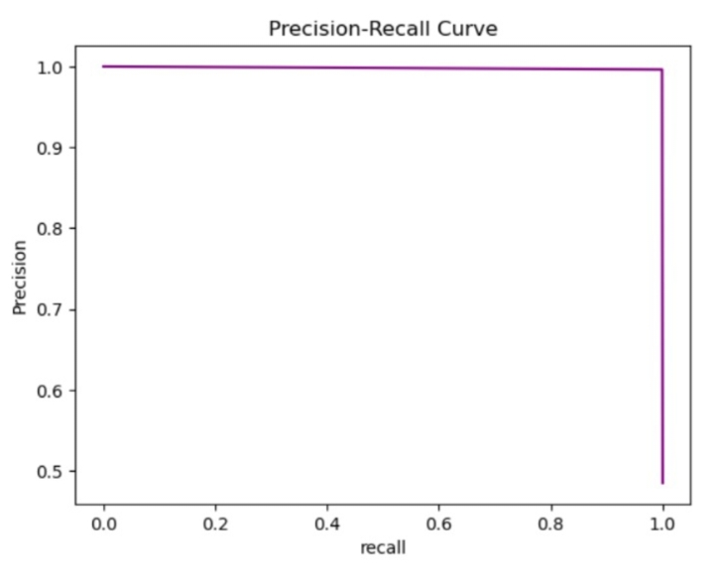
PRC Curve for Random Forest

Slide 12
Feature Engineering:
Using RFE Method

Slide 13
Dataframe 3:
Conclusion: Here Random Forest is the best fitted model.
Sr.No. | Model Name | Accuracy | TPR | FPR | F1 Score
1 | Logistic Regression | 62.574257 | 1.000000 | 1.000000 | 0.769793
2 | Decision Tree | 98.910891 | 0.988291 | 0.009524 | 0.991271
3 | Random Forest | 98.910891 | 0.988291 | 0.009524 | 0.991271
4 | SVM | 67.861386 | 0.934810 | 0.749735 | 0.784491
5 | KNN | 97.287129 | 0.987975 | 0.052381 | 0.978530
6 | Naive Bayes | 57.920792 | 0.567089 | 0.400529 | 0.627781
7 | Adaboost | 98.910891 | 0.988291 | 0.009524 | 0.991271
8 | xgboost | 98.910891 | 0.988291 | 0.009524 | 0.991271

Slide 14
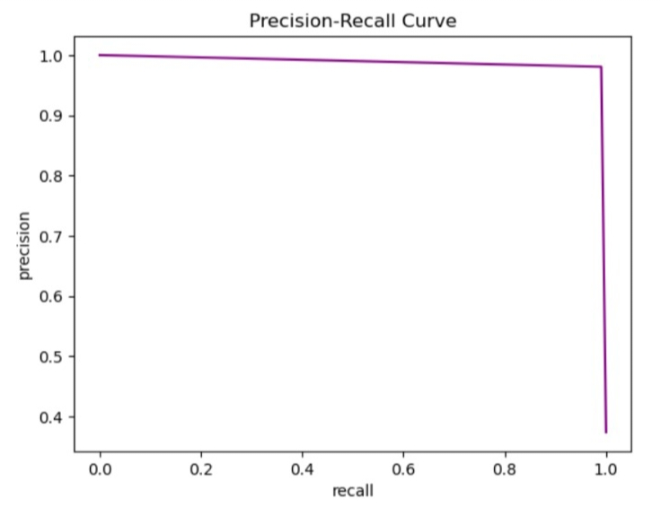
PRC Curve for Random Forest

Slide 15
Merits: (1) A prediction model can help to identify individuals at risk of developing respiratory disease before symptoms manifest.
(2) Predictive models can empower individuals to take proactive steps to manage their respiratory health through lifestyle changes.
Demerits: (1)Prediction models may produce false positives leading to unnecessary anxiety or missed opportunities for timely treatment.
(2) Complex prediction models may lack transparency , making it challenging for healthcare providers.

Slide 16
Thank You!!

